Slide 1
BIG DATA AND CLOUD COMPUTING
Prepared by,
J.GLADYS AANI SUJITHA,
AP/CSE.

Slide 2
COURSE OBJECTIVES:
COB1: To explore the fundamental concepts of big data analytics
COB2: To learn to build and maintain reliable, scalable, distributed systems with Apache Hadoop.
COB3:To understand the foundation on various types of cloud services, technologies and service providers.
COB4:To comprehend the technical capabilities and business benefits of virtualization and cloud computing.
COB5:To study the design challenges of Big Data and cloud.

Slide 3
INTRODUCTION TO-BIG DATA
Big Data is a collection of data that is huge in volume, yet growing exponentially with time.
It is data with so large a size and complexity that none of the traditional data management tools can store it or process it efficiently.
Big data is also data but with a huge size.'

Slide 4
Traditional Data Vs Big Data

Slide 5
Types of Bigdata
There are -three main types of big data :
Structured,
• Semi:-structured, and
• Unstructured data.

Slide 6
Big Data Analytics
Big data analytics is a method to uncover the hidden designs in large data, to extract useful information.
Big data analytics is a process of inspecting, differentiating and transforming big data with the goal of identifying useful information, suggesting conclusion and helping to take accurate decisions.
Analytics include both data mining and communication or guide decision making.

Slide 7
The importance of big data analytics
Big data analytics through specialized systems and software can lead to positive business related outcomes:
New revenue opportunities
More effective marketing
Better customer service
Improved operational efficiency
Competitive advantages over rivals

Slide 8
How big data analytics works
Once the data is ready, it can be analyzed with the software commonly used for advanced analytics processes. That includes tools for:
data mining, which shift through data sets in search of patterns and relationships;
predictive analytics, which build models to forecast customer behavior and other future developments;
machine learning, which taps algorithms to analyze large data sets; and
deep learning, a more advanced offshoot of machine learning.

Slide 9
Working of big data analytics
Data Collection
Data Cleaning (Data Preprocessing)
Data Processing
Data Analysis
Data Visualization
Data Storage and Management
Continuous Learning and Improvement

Slide 10
Types of Big Data Analytics
Descriptive Analytics: This type helps us understand past events. In social media, it shows performance metrics, like the number of likes on a post.
Diagnostic Analytics: In Diagnostic analytics delves deeper to uncover the reasons behind past events. In healthcare, it identifies the causes of high patient re-admissions.
Predictive Analytics: Predictive analytics forecasts future events based on past data. Weather forecasting, for example, predicts tomorrow's weather by analyzing historical patterns.

Slide 11
Prescriptive Analytics: However, this category not only predicts results but also offers recommendations for action to achieve the best results. In e-commerce, it may suggest the best price for a product to achieve the highest possible profit.
Real-time Analytics: The key function of real-time analytics is data processing in real time. It swiftly allows traders to make decisions based on real-time market events.
Spatial Analytics: Spatial analytics is about the location data. In urban management, it optimizes traffic flow from the data unde the sensors and cameras to minimize the traffic jam.
Text Analytics: Text analytics delves into the unstructured data of text. In the hotel business, it can use the guest reviews to enhance services and guest satisfaction.

Slide 12
Big Data Analytics Technologies and Tools
Hadoop
Spark
NoSQL Databases
Tableau
Machine Learning Frameworks (e.g., TensorFlow):

Slide 13
Challenges of Big data analytics
Data Overload
Data Quality
Privacy Concerns
Security Risks
Costs

Slide 14
Usage of Big Data Analytics
Healthcare: It aids in precise diagnoses and disease prediction, elevating patient care.
Retail: Amazon's use of Big Data Analytics offers personalized product recommendations based on your shopping history, creating a more tailored and enjoyable shopping experience.
Finance: Credit card companies such as Visa rely on Big Data Analytics to swiftly identify and prevent fraudulent transactions, ensuring the safety of your financial assets.

Slide 15
Transportation: Companies like Uber use Big Data Analytics to optimize drivers' routes and predict demand, reducing wait times and improving overall transportation experiences.
Agriculture: Farmers make informed decisions, boosting crop yields while conserving resources.

Slide 16
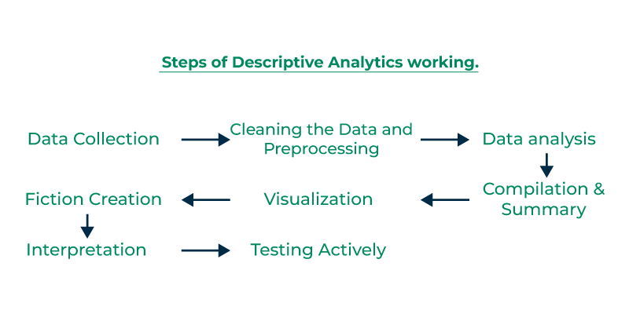
Types of Big Data Analytics
Descriptive Analytics

Slide 17
Diagnostic Analytics:
In Diagnostic analytics delves deeper to uncover the reasons behind past events. In healthcare, it identifies the causes of high patient re-admissions.
he primary purpose of diagnostic analytics is to uncover the root causes behind trends, anomalies, or issues identified through data analysis. It goes beyond simply describing what's happening (descriptive analytics) to understanding why it's happening.

Slide 18

Predictive Analytics:
Predictive analytics forecasts future events based on past data. Weather forecasting, for example, predicts tomorrow's weather by analyzing historical patterns.
Predictive analytics is a branch of data science that leverages statistical techniques, machine learning algorithms, and historical data to make data-driven predictions about future outcomes.

Slide 19
Prescriptive analytics is used to make next-level and advanced usage of predicted data.
Business enterprises use the predicted possibilities to develop and provide better services to their customers/consumers.
For Example, For a successful and cost-effective delivery system transportation enterprises used algorithms and predictive models to decide the best route with minimum energy usage for saving time and increasing profits.

Slide 20
Real-time Analytics:
The key function of real-time analytics is data processing in real time. It swiftly allows traders to make decisions based on real-time market events.
Real-time analytics involves continuously processing and analyzing data immediately as it is collected, enabling instant decision-making and responses.
For example, real-time big data analytics uses data in financial databases to notify trading decisions.

Slide 21
Spatial Analytics:
Spatial analytics is about the location data. In urban management, it optimizes traffic flow from the data unde the sensors and cameras to minimize the traffic jam.
The world is overflowing with data, but this data only becomes valuable when we can derive meaningful insights from it.
Spatial analysis is the process of using analytical tools to study and represent data, uncovering relationships and patterns within geospatial data.
This method transforms raw data into actionable information by analyzing geographic features collected through satellites, maps, and other sources.
It employs a range of analytical techniques, algorithms, and computational models to draw connections between data points and apply them to targeted systems such as environmental management, urban planning, and more.

Slide 22
Text Analytics:
Text analytics delves into the unstructured data of text. In the hotel business, it can use the guest reviews to enhance services and guest satisfaction.
Text Analytics is a process of analyzing and understanding written or spoken language.
It employs computer algorithms and techniques to extract valuable information, patterns, and insights from extensive textual data.
In simpler terms, text analytics empowers computers to understand and interpret human language.
In simpler terms, text analytics helps computers understand and interpret human language.

Slide 23
Applications and key data sources for big data and business analytics

Slide 24
Characteristics of Big Data
➢5V’s (Volume, Velocity, Variety, Veracity, and Value)
➢Volume: Data size
➢Velocity: Data production speed
➢Variety: Data oriented from various things
➢Veracity: Data accuracy (Trustworthy)
➢Value: Data value

Slide 26
1. Volume:
Volume means “How much Data is generated”. Now-a-days, Organizations or Human Beings or Systems are generating or getting very vast amount of Data say TB(TeraBytes) to PB(Peta Bytes) to ExaByte(EB) and more.
VOLUME=VERY LARGE AMOUNT OF DATA

Slide 27
2. Velocity:
Velocity means “How fast produce Data”. Now-a-days, Organizations or Human Beings or Systems are generating huge amounts of Data at very fast rate.
VELOCITY=PRODUCE DATA AT VERY FAST RATE

Slide 28
3. Variety:
Variety means “Different forms of Data”. Now-a-days, Organizations or Human Beings or Systems are generating very huge amount of data at very fast rate in different formats.
We will discuss in details about different formats of Data soon.
VARIETY= PRODUCE DATA IN DIFFERENT FORMAT

Slide 29
Veracity
Veracity means “The Quality or Correctness or Accuracy of Captured Data”. Out of 4Vs, it is most important V for any Big Data Solutions.
Because without Correct Information or Data, there is no use of storing large amount of data at fast rate and different formats.
That data should give correct business value.
VERACITY=THE CORRECTNESS OF DATA

Slide 30
BIG DATA ARCHITECTURE
“Big Data architecture is the logical and/or physical layout/structure of how Big Data will be stored, accessed and managed within a Big Data or IT environment”

Slide 31
• Layered Architecture
It works well whenever system requirements call for independent tasks organized hierarchically.
Architecture layers have been used in databases, operating, computer-to-computer communications, and now in big data.

Slide 32
A layered architecture is designed as a hierarchy of client-server processes that minimizes interaction between layers.
Each layer acts as a client for the module above it and acts as a server for the module below it in an architecture layer.

Slide 33
• Big Data Generic Architecture:
Big Data uses a multi-layer architecture

Slide 34
Big Data Architecture Layers:
Big Data Source Layer: • Big data include the both batch and stream data:
Structured data
Semi-structured data
Unstructured data
Big Data Storage Layer: • Depending of the big data project, data can be stored in HDFS, NoSQL database, etc..
Big Data Preparation Layer: • It processes data from the source, converts the data into a format ready for both storage and analysis.
Big Data Analytics Layer: • It handles both batch and stream data analytics.
Visualization Layer: • It receives results from the big data analysis layer and visualize them in dashboard, charts, etc.

Slide 36
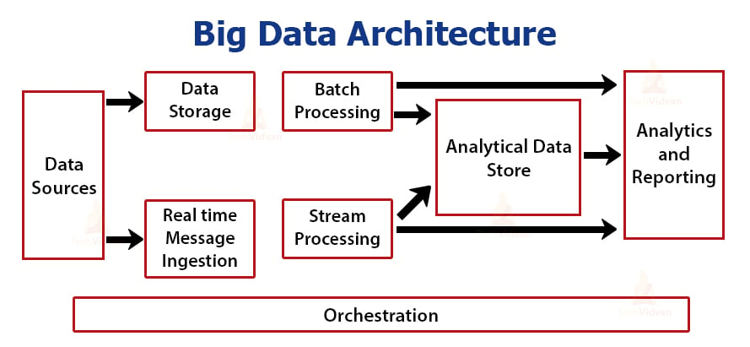

Slide 37
Data Sources:
Data sources, open and third-party, play a significant role in architecture.
Relational databases, data warehouses, cloud-based data warehouses, SaaS applications, real-time data from company servers and sensors such as IoT devices, third-party data providers, and also static files such as Windows logs, comprise several data sources.
Both batch processing and real-time processing are possible.
The data managed can be both batch processing and real-time processing.

Slide 38
Data Storage:
There is data stored in file stores that are distributed in nature and that can hold a variety of format-based big files.
It is also possible to store large numbers of different format-based big files in the data lake.
This consists of the data that is managed for batch built operations and is saved in the file stores.

Slide 39
Batch Processing:
Each chunk of data is split into different categories using long-running jobs, which filter and aggregate and also prepare data for analysis.
These jobs typically require sources, process them, and deliver the processed files to new files.

Slide 40
Real Time-Based Message Ingestion:
A real-time streaming system that caters to the data being generated in a sequential and uniform fashion is a batch processing system.
When compared to batch processing, this includes all real-time streaming systems that cater to the data being generated at the time it is received.
This data mart or store, which receives all incoming messages and discards them into a folder for data processing, is usually the only one that needs to be contacted.
Message-based ingestion stores such as Apache Kafka, Apache Flume, Event hubs from Azure, and others, on the other hand, must be used if message-based processing is required.
The delivery process, along with other message queuing semantics, is generally more reliable.

Slide 41
Stream Processing:
Real-time message ingest and stream processing are different.
The latter uses the ingested data as a publish-subscribe tool, whereas the former takes into account all of the ingested data in the first place and then utilises it as a publish-subscribe tool.
Stream processing, on the other hand, handles all of that streaming data in the form of windows or streams and writes it to the sink.
This includes Apache Spark, Flink, Storm, etc.

Slide 42
Analytics-Based Datastore:
In order to analyze and process already processed data, analytical tools use the data store that is based on HBase or any other NoSQL data warehouse technology.
The data can be presented with the help of a hive database, which can provide metadata abstraction, or interactive use of a hive database, which can provide metadata abstraction in the data store.
NoSQL databases like HBase or Spark SQL are also available.

Slide 43
Reporting and Analysis:
The generated insights, on the other hand, must be processed and that is effectively accomplished by the reporting and analysis tools that utilize embedded technology and a solution to produce useful graphs, analysis, and insights that are beneficial to the businesses.

Slide 44
Orchestration:
Data-based solutions that utilise big data are data-related tasks that are repetitive in nature, and which are also contained in workflow chains that can transform the source data and also move data across sources as well as sinks and loads in stores.

Slide 45
Types of Big Data Architecture
Lambda Architecture
A single Lambda architecture handles both batch (static) data and real-time processing data.
Batch Layer
Speed Layer
Serving Layer

Slide 46
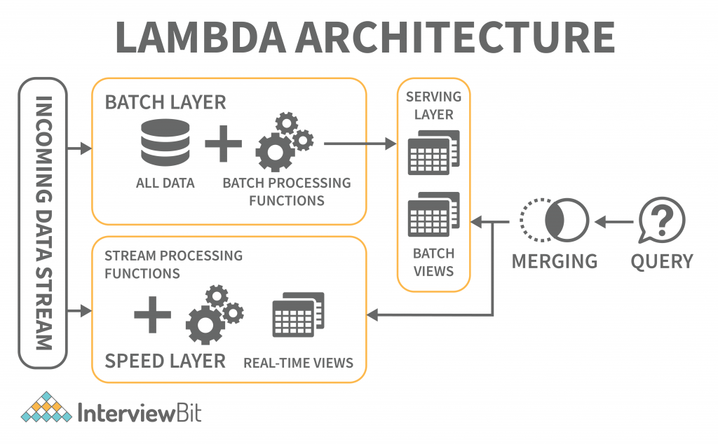

Slide 47
Kappa Architecture
When compared to Lambda architecture, Kappa architecture is also intended to handle both real-time streaming and batch processing data.
The Kappa architecture, in addition to reducing the additional cost that comes from the Lambda architecture, replaces the data sourcing medium with message queues.
The messaging engines store a sequence of data in the analytical databases, which are then read and converted into appropriate format before being saved for the end-user.
The batch layer was eliminated in the Kappa architecture

Slide 48
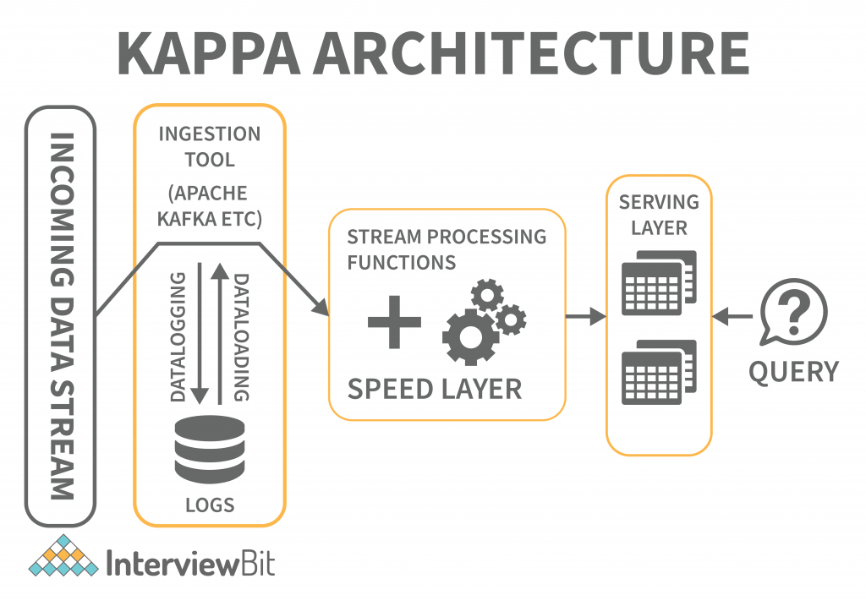

Slide 49
Big Data Tools and Techniques
A big data tool can be classified into the four buckets listed below based on its practicability.
Massively Parallel Processing (MPP)
No-SQL Databases
Distributed Storage and Processing Tools
Cloud Computing Tools

Slide 50
Massively Parallel Processing (MPP)
A loosely coupled or shared nothing storage system is a massively parallel processing construct with the goal of dividing up a large number of computing machines into discrete pieces and proceeding in parallel.
An MPP system is also referred to as a loosely coupled or shared nothing system.
Processing is accomplished by breaking a large number of computer processors into separate bits and proceeding in parallel.
Each processor works on separate tasks, has a different operating system, and does not share memory.

Slide 51
It is also possible for up to 200 or more processors to work on applications connected to this high-speed network.
In each case, the processor handles a different set of instructions and has a different operating system, which is not shared.
MPP may also send messages between processes via a messaging system that allows it to send commands to the processors.
MPP-based databases are IBM Netezza, Oracle Exadata, Teradata, SAP HANA, EMC Greenplum.

Slide 52
No-SQL Databases
Structures are employed to help associate data with a particular domain.
Data cannot be stored in a structured database unless it is first converted to one.
SQL (or NoSQL) is a non-structured language used to encapsulate unstructured data and create structures for heterogeneous data in the same domain.
NoSQL databases offer a vast array of configuration scalability, as well as versatility, and scalability in handling large quantities of data.
There is also distributed data storage, making data available locally or remotely.

Slide 53
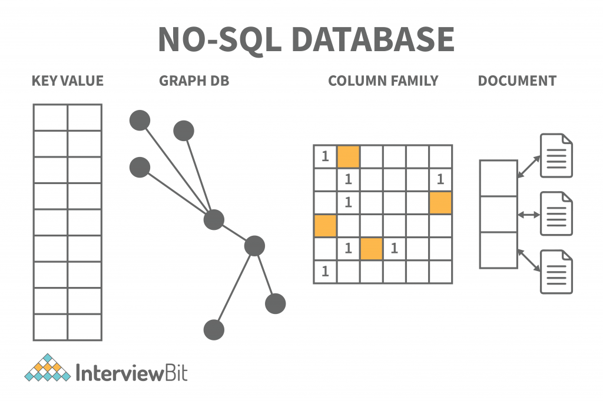

Slide 54
Distributed Storage and Processing Tools
A distributed database is a set of data storage chunks that is distributed over a network of computers.
Data centres may have their own processing units for distributed databases.
The distributed databases may be physically located in the same location or dispersed over an interconnected network of computers.
The distributed databases are heterogeneous (having a variety of software and hardware), homogeneous (having the same software and hardware across all instances), and different, supported by distinct hardware.
The leading big data processing and distribution platforms are Hadoop HDFS, Snowflake, Qubole, Apache Spark, Azure HDInsight, Azure Data Lake, Amazon EMR, Google BigQuery, Google Cloud Dataflow, MS SQL.

Slide 55
Cloud Computing Tools
Cloud Computing Tools refers to the network-based computing services that utilise the Internet’s development and services.
The shared pool of configurable computing resources, which are available at any time and anywhere and at any time, are shared by all network-based services.
This service is available for paid-for use when required and is provided by the service provider.

Slide 56
The platform is very useful in handling large amounts of data.
Amazon Web Services (AWS) is the most popular cloud computing tool, followed by Microsoft Azure, Google Cloud, Blob Storage, and DataBricks.
Oracle, IBM, and Alibaba are also popular cloud computing tools.

Slide 57
Big Data workflow
A Big Data workflow is the computerized modeling and automation of a process consisting of multiple orchestrated steps that perform various data analysis tasks.
Most Big Data workflows are usually represented by a Directed Acyclic Graph (DAG) .
Various processing models can be applied for parallelizing data processing known as workflow data patterns.

Slide 58
In this context, Pipe and Filter (P&F) is a relevant architectural design to decompose a larger processing task into a series of smaller, separate processing steps (filters) that are connected by channels (pipes).
The filters can then be integrated into a workflow, whereby each filter receives and sends data in a standardized way, thus implementing the “shared data passed by reference” pattern.
This pattern, given that different steps are loosely coupled, enables scalability at the workflow step level, but introduces the issue of handling concurrency control.

Slide 59
Application of Big Data

Slide 60
Here is the list of top Big Data applications in today’s world:
•Big Data in Healthcare
•Big Data in Education
•Big Data in E-commerce
•Big Data in Media and Entertainment
•Big Data in Finance
•Big Data in Travel Industry
•Big Data in Telecom
•Big Data in Automobile

Slide 61
1. Big Data in Retail
▪The retail industry is the one that faces the most fierce competition of all.
Retailers constantly hunt for ways that will give them a competitive edge over others.
Customers are the real king sounds legit for the retail industry in particular.
▪For retailers to thrive in this competitive world, they need to understand their customers in a better way.
If they are aware of their customers’ needs and how to fulfill those needs in the best possible way, then they know everything.

Slide 62
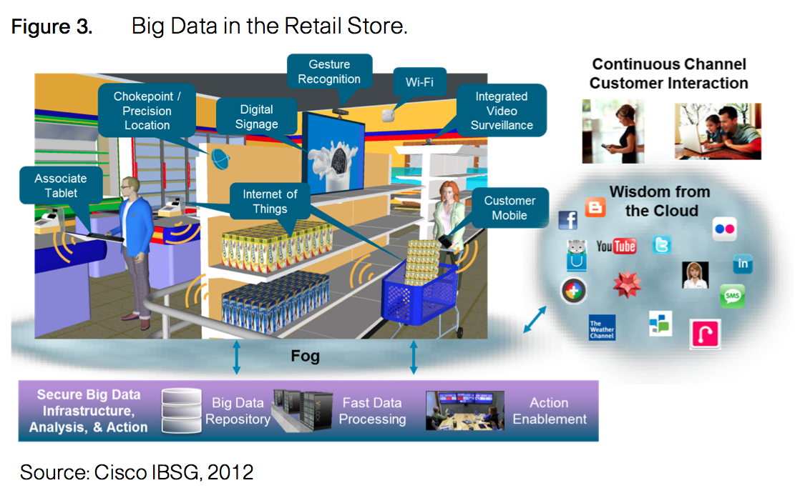

Slide 63
2. Big Data in Healthcare
Big Data and healthcare are an ideal match. It complements the healthcare industry better than anything ever will. The amount of data the healthcare industry has to deal with is unimaginable.
Gone are the days when healthcare practitioners were incapable of harnessing this data. From finding a cure to cancer to detecting Ebola and much more, Big Data has got it all under its belt and researchers have seen some life-saving outcomes through it.
Big Data and analytics have given them the license to build more personalized medications. Data analysts are harnessing this data to develop more and more effective treatments. Identifying unusual patterns of certain medicines to discover ways for developing more economical solutions is a common practice these days.

Slide 64
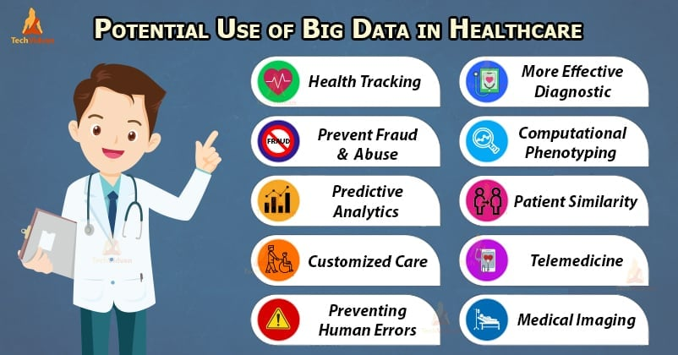

Slide 65
Big Data in Education
When you ask people about the use of the data that an educational institute gathers, the majority of the people will have the same answer that the institute or the student might need it for future references.
Even you had the same perception about this data, didn’t you? But the fact is, this data holds enormous importance.
Big Data is the key to shaping the future of the people and has the power to transform the education system for better.
Some of the top universities are using Big Data as a tool to renovate their academic curriculum.
Additionally, universities can even track the dropout rates of the students and are taking the required measures to reduce this rate as much as possible.

Slide 66
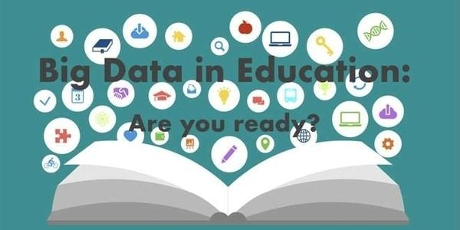

Slide 67
Big Data in E-commerce
One of the greatest revolutions this generation has seen is that of E-commerce.
It is now part and parcel of our routine life.
Whenever we need to buy something, the first thought that provokes our mind is E-commerce.
And not your surprise, Big Data has been the face of it.
▪Some of the biggest E-commerce companies of the world like Amazon, Flipkart, Alibaba, and many more are now bound to Big Data and analytics is itself an evidence of the level of popularity Big Data has gained in recent times.
▪Big Data is now as important as anyone else in these organizations.Amazon, the biggest E-commerce firm in the world and one of the pioneers of Big Data and analytics, has Big Data as the backbone of its system. Flipkart, the biggest E-commerce firm in India, has one of the most robust data platforms in the country.

Slide 68
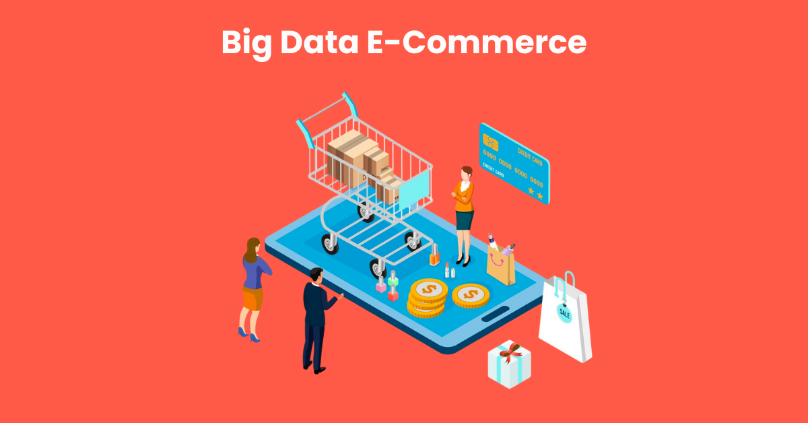

Slide 69
Big Data in Media and Entertainment
Media and Entertainment industry is all about art and employingBig Datain it is a sheer piece of art.
Art and science are often considered to be the two completely contrasting domains but when employed together, they do make a deadly duo and Big Data’s endeavors in the media industry are a perfect example of it.
Viewers these days need content according to their choices only. Content that is relatively new to what they saw the previous time. Earlier the companies broadcasted the Ads randomly without any kind of analysis.
But after the advent of Big Data analytics in the industry, companies now are aware of the kind of Ads that attracts a customer and the most appropriate time to broadcast it for seeking maximum attention.
Customers are now the real heroes of the Media and entertainment industry -courtesy to Big Data and Analytics.

Slide 70
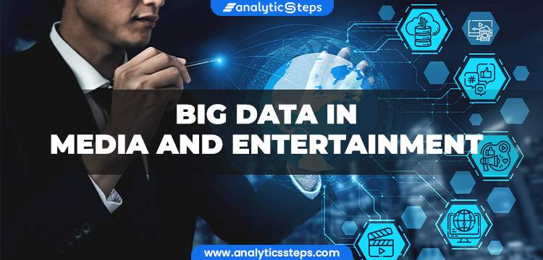

Slide 71
Big Data in Finance
The functioning of any financial organization depends heavily on its data and to safeguard that data is one of the toughest challenges any financial firm faces.
Data has been the second most important commodity for them after money.
▪Even before Big Data gained popularity, the finance industry was already conquering the technical field.
In addition to it, financial firms were among the earliest adopters of Big Data and Analytics.

Slide 72
Digital bankingandpaymentsare two of the most trending buzzwords around and Big data has been at the heart of it.
Big Data is bossing the key areas of financial firms such asfraud detection,risk analysis,algorithmic trading, andcustomer contentment.
▪This has brought much-needed fluency in their systems.
They are now empowered to focus more on providing better services to their customers rather than focussingon security issues.
Big Data has now enhanced the financial system with answers to its hardest of the challenges.

Slide 73
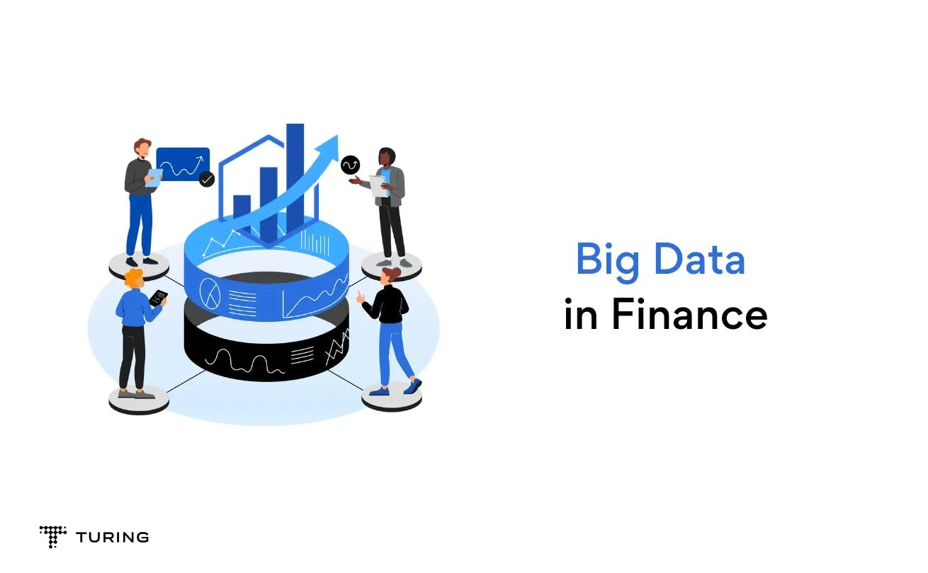

Slide 74
Big Data in Travel Industry
While Big Data is spreading like wildfire and various industries have been cooking its food with it, the travel industry was a bit late to realize its worth.
Better late than never though. Having a stress-free traveling experience is still like a daydream for many.
And now Big Data’s arrival is like a ray of hope, that will mark the departure of all the hindrances in our smooth traveling experience.
Through Big Data and analytics, travel companies are now able to offer more customized traveling experience.
They are now able to understand their customer’s requirements in a much-enhanced way.
From providing them with the best offers to be able to make suggestions in real-time, Big Data is certainly a perfect guide for any traveler.
Big Data is gradually taking the window seat in the travel industry.

Slide 75
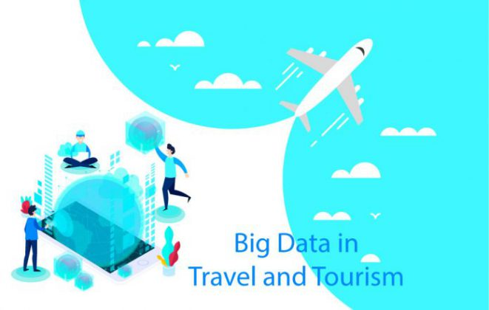

Slide 76
Big Data in Telecom
The telecom industry is the soul of every digital revolution that takes place around the world.
With the ever-increasing popularity of smartphones, it has flooded the telecom industry with massive amounts of data.
▪And this data is like a goldmine, telecom companies just need to know how to dig it properly.
Through Big Data and analytics, companies are able to provide the customers with smooth connectivity, thus eradicating all the network barriers that the customers have to deal with.
Companies now with the help of Big Data and analytics can track the areas with the lowest as well as the highest network traffics and thus doing the needful to ensure hassle-free network connectivity.
Big Data alike other industries have helped the telecom industry to understand its customers pretty well.
Telecom industries now provide customers with offers as customized as possible.
▪Big Data has been behind the data revolution we are currently experiencing.

Slide 77
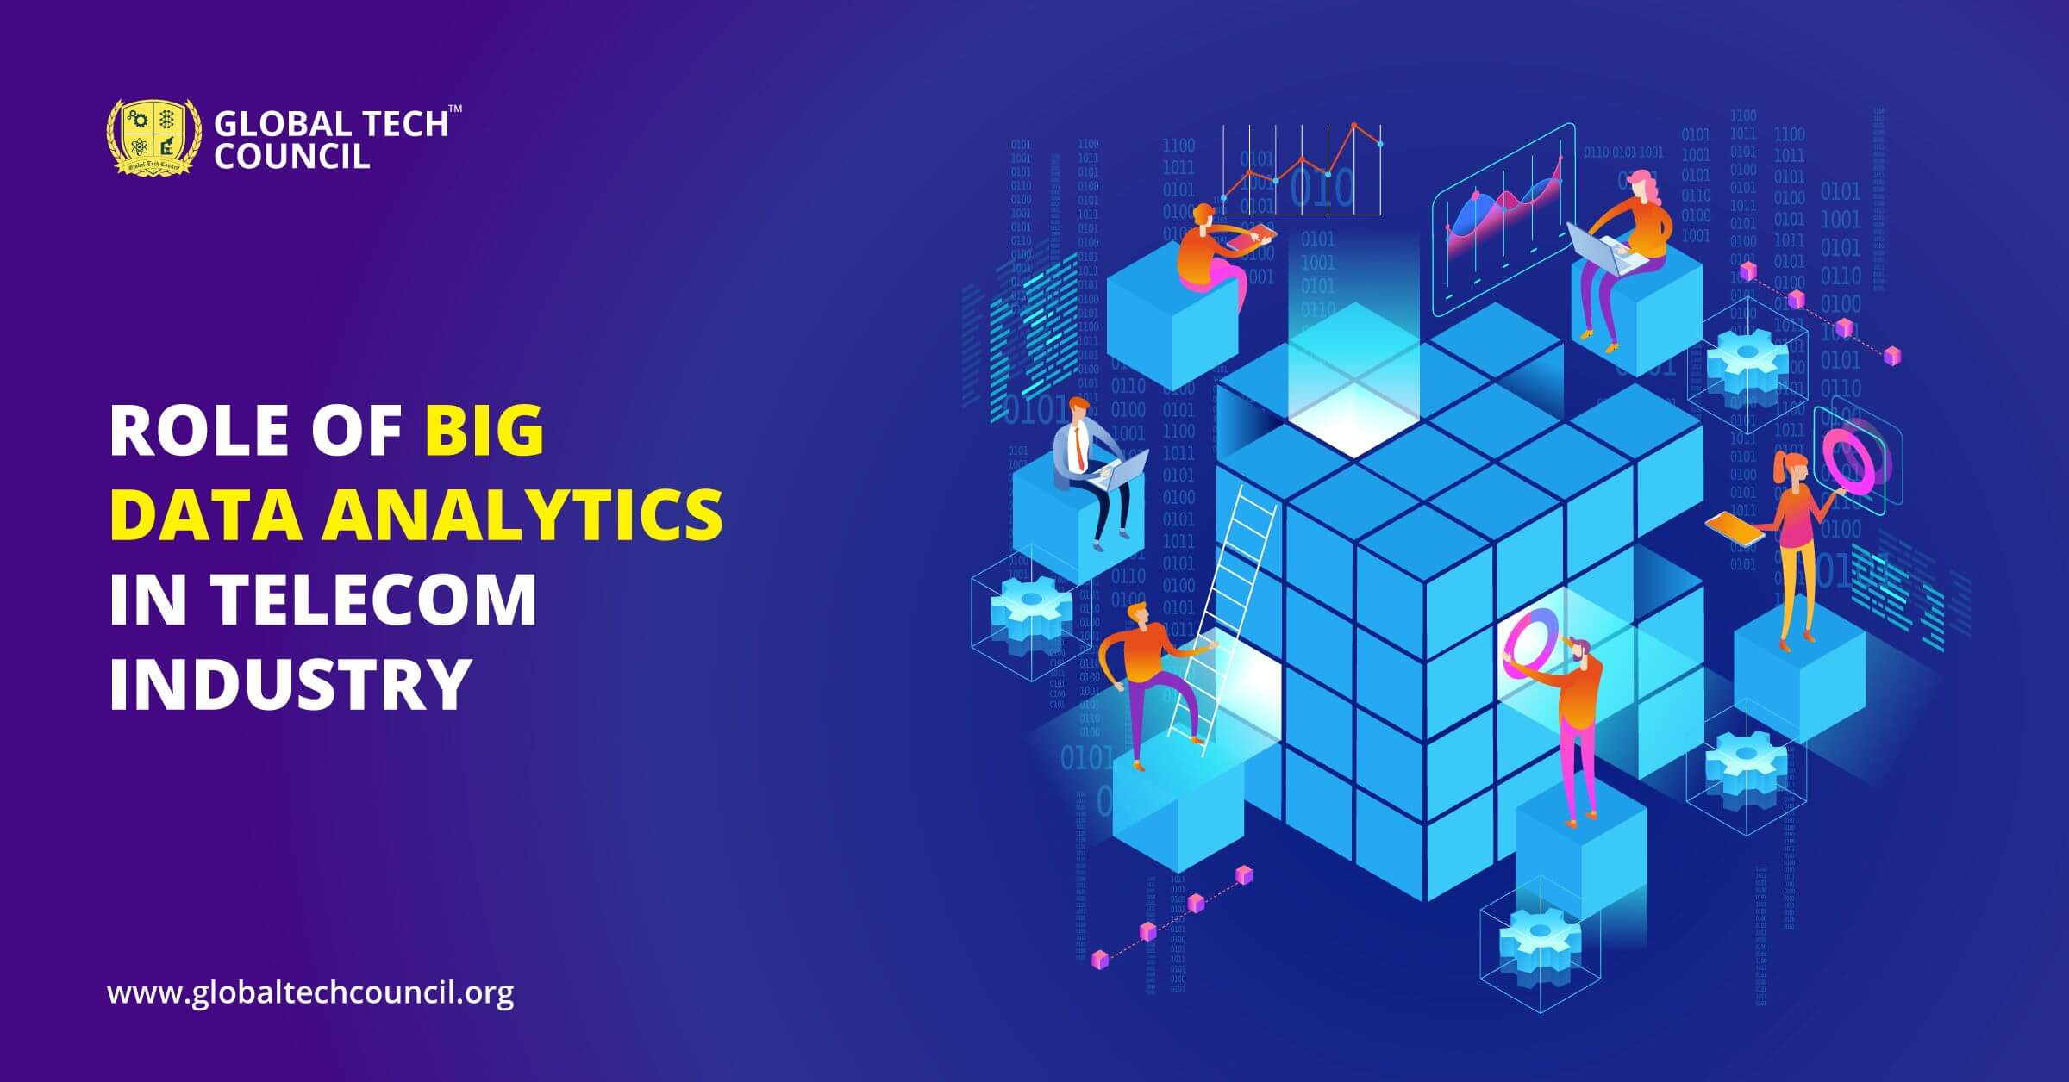

Slide 78
Big Data in Automobile
And Big Data has now taken complete control of the automobile industry and is driving it smoothly.
Big Data is driving the automobile industry towards some unbelievable and never before results.
▪The automobile industry is on a roll and Big Data is its wheels or I must say Big Data has given wings to it.
Big Data has helped the automobile industry achieve things that were beyond our imaginations.
From analyzing the trends to understanding the supply chain management, from taking care of its customers to turning our wildest dream of connected cars a reality, Big Data is well and truly driving the automobile industry crazy.

Slide 79
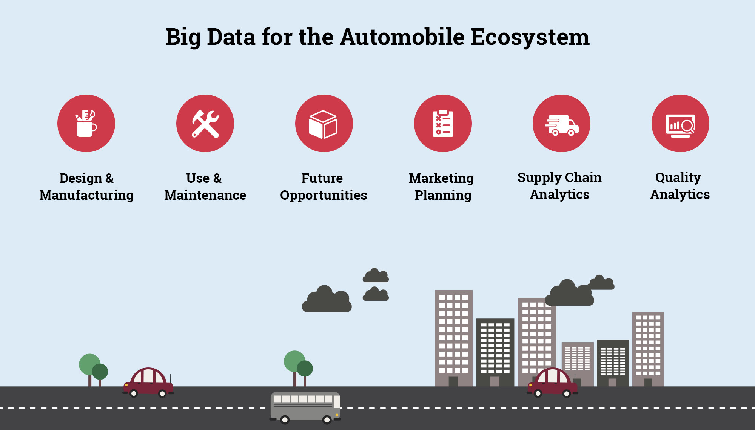

Slide 80
THANK YOU

